Slide 1

Practical Research: Planning and Design
Twelfth Edition
Chapter 7
Experimental, Quasi-Experimental, and Ex Post Facto Designs
Copyright © 2019, 2016, 2013 Pearson Education, Inc. All Rights Reserved
Notes:
If this PowerPoint presentation contains mathematical equations, you may need to check that your computer has the following installed:
1) Math Type Plugin
2) Math Player (free versions available)
3) NVDA Reader (free versions available)

Slide 2
Experimental Studies
Used to test for cause-and-effect relationships
Many possible factors might cause or influence a particular condition or phenomenon
The researcher controls for all influential factors except those whose possible effects are the focus of investigation

Slide 3
Variables
Variable: quality or characteristic that has two or more values
Independent Variable
the researcher studies as a possible cause of something else
the researcher directly manipulates
Dependent Variable
potentially influenced by (depends on) the independent variable

Slide 4
Internal Validity
The extent to which the design of a research study and the data it yields allow the researcher to draw accurate conclusions about cause-and-effect and other relationships
Experimental designs must be internally valid, or the results are not interpretable

Slide 5
Confounding Variables (1 of 2)
Factors that might account for differences that are not attributable to the particular treatment or intervention being studied

Slide 6
Confounding Variables (2 of 2)
Example:
Two classes use different methods of teaching science
Teaching method = independent variable
Two different teachers = confounding variable
Teachers of different sex = another confounding variable
Time of day the class taught = another confounding variable

Slide 7
Strategies for Controlling Confounding Variables (1 of 2)
Keep some things constant
Example: Heterogeneous sample
Include a control group
Conduct a double-blind experiment
participants and individuals administering varying interventions or control conditions are equally “in the dark”
Randomly assign people to groups

Slide 8
Strategies for Controlling Confounding Variables (2 of 2)
Use one or more pretests to assess equivalence before the treatment(s)
matched pairs
Expose participants to all experimental treatments
within-subjects or repeated-measures variablea
Statistically control for confounding variables
partial correlation, A N C O V A, S E M
Remember, a carefully controlled experimental design is the only approach that allows you to draw firm conclusions about cause and effect.

Slide 9
Experimental Designs
“True” experimental designs have a truly independent variable, manipulated by the researcher
Experimental designs offer control and internal validity
Variations:
Pre-experimental designs
Quasi-experimental designs
Ex post facto designs
Factorial designs

Slide 10
Pre-Experimental Designs (1 of 2)
Differ from experimental designs in that:
the independent variable doesn’t vary
experimental and control groups are not composed of equivalent or randomly selected individuals
Not possible to show cause-and-effect relationships
Should be followed by more controlled experiments

Slide 11
Pre-Experimental Designs (2 of 2)
One-Shot Experimental Case Study
Group 1 Tx
Obs
One-Group Pretest-Posttest Design
Group 1 Obs
Tx
Obs
Static Group Comparison
Group 1 Tx
Obs
Group 1 --- Obs

Slide 12
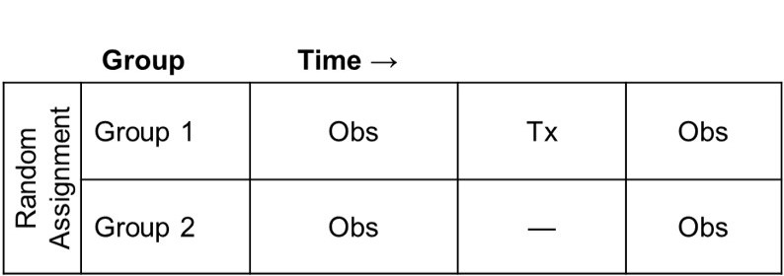
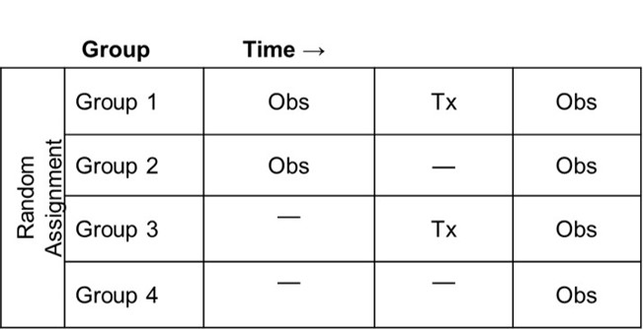
True Experimental Designs (1 of 2)
Pretest-Posttest Control Group Design (random assignment)
Solomon Four-Group Design (enhances external validity)

Slide 13
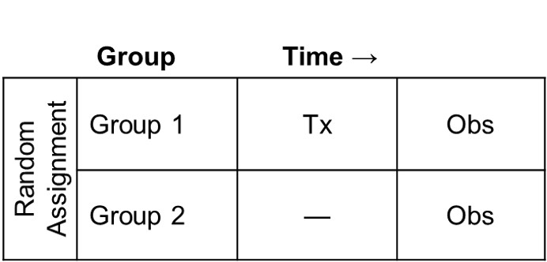
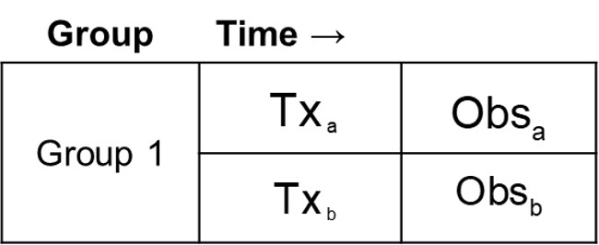
True Experimental Designs (2 of 2)
Posttest Only Control Group Design
Within Subjects Design

Slide 14
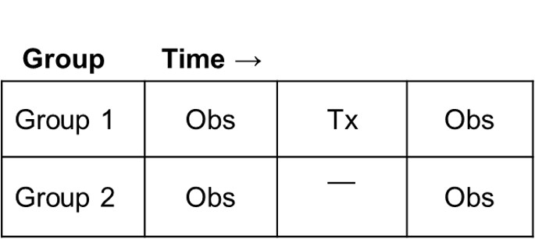
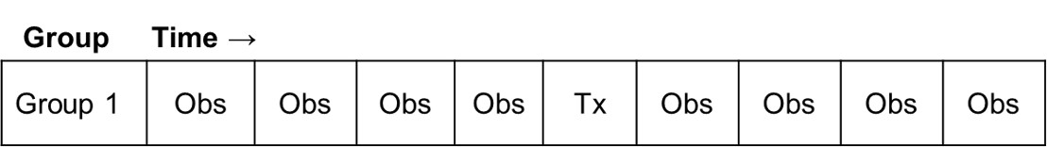
Quasi-Experimental Design (1 of 3)
Randomness is not possible or practical
can’t control for all confounding variables
Nonrandomized Control-Group Pretest-Posttest Design
Simple Time-Series Design

Slide 15
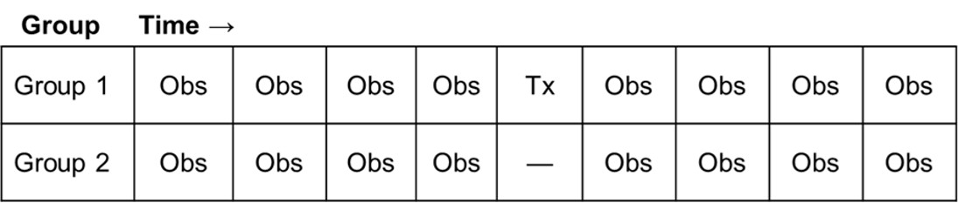
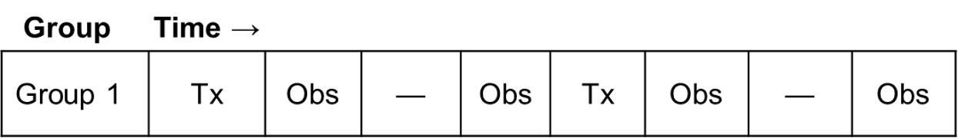
Quasi-Experimental Design (2 of 3)
Control-Group Time-Series Design
Reversal Time-Series Design

Slide 16
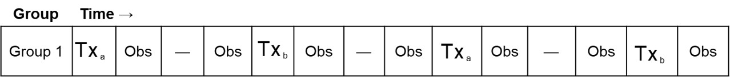
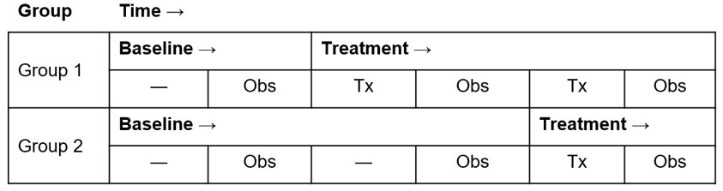
Quasi-Experimental Design (3 of 3)
Alternating-Treatments Design
Multiple Baseline Design

Slide 17
Single-Subject Designs
Reversal time-series, alternating treatments, and multiple-baseline designs might also be used with either a single individual or a single intact group.
This approach is known as single-case intervention research.

Slide 18
Ex Post Facto Design (1 of 3)
Researcher identifies events that have already occurred or conditions that are already present and collects data to investigate a possible relationship between these factors and subsequent characteristics or behaviors
Often confused with correlational or experimental designs

Slide 19
Ex Post Facto Design (2 of 3)
involves looking at existing circumstances (like correlational research)
has clearly identifiable independent and dependent variables (like experimental research)
involves no direct manipulation of the independent variable – the presumed “cause” has already occurred (unlike experimental research)

Slide 20
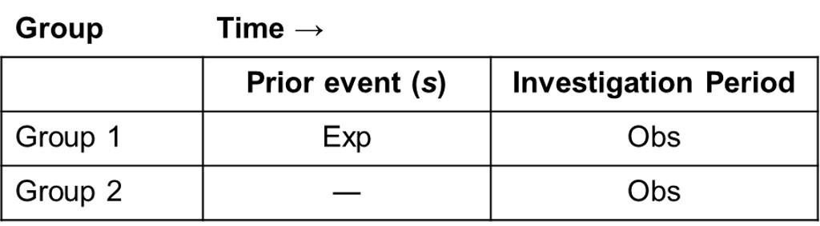
Ex Post Facto Design (3 of 3)
Simple Ex Post Facto Design

Slide 21
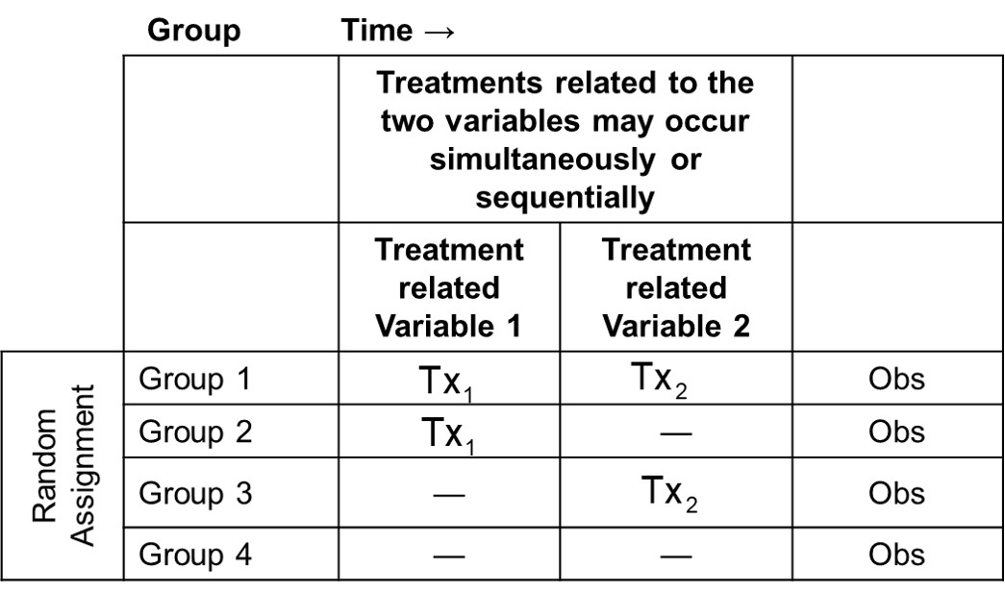
Factorial Design (1 of 2)
Two or more independent variables in a single study
Two-Factor Experimental Design
Notes:
Long Description:
The details of the table are as follows: treatments related to the two variables may occur simultaneously or sequentially; the treatment related variable 1 and treatment related variable 2 are as follows: random assignment; group 1, Tx sub 1, Tx sub 2, Obs; group 2, Tx sub 1, nil, Obs; group 3, nil, Tx sub 2, Obs; group 4, nil, nil, Obs.

Slide 22
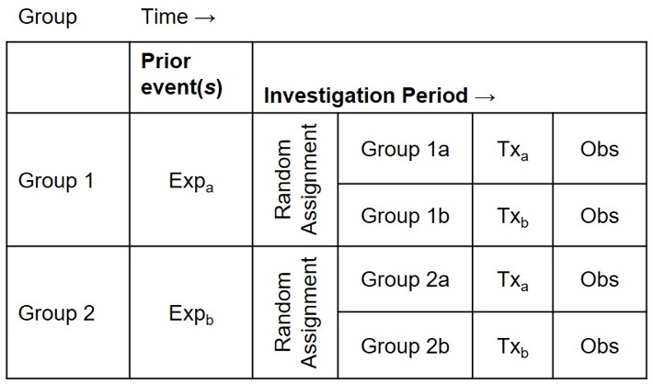
Factorial Design (2 of 2)
Combined experimental and ex post facto design
Notes:
Long Description:
The details of the table are as follows: group 1, prior event, Exp sub a; investigation period, group 1 a, Tx sub a and Obs; group 1 b, Tx sub b and Obs; group 2, prior event, Exp sub b; investigation period, group 2 a, Tx sub a and Obs; group 2 b, Tx sub b and Obs.

Slide 23
Meta-Analysis
Statistical technique: Analysis of the analyses
Researcher combines results of many experimental and/or ex post facto studies to determine whether they lead to consistent conclusions

Slide 24
Conducting Experiments on the Internet
Some websites are set up to assist you
Keep ethics in mind
Remember your sample will probably not be representative

Slide 25
Acknowledging Bias
Occurs even in the most controlled designs
variables may be ignored
sample may not be representative
tasks or setting may be artificial
Identify it, acknowledge it, and report it

Slide 26

Copyright
This work is protected by United States copyright laws and is provided solely for the use of instructors in teaching their courses and assessing student learning. Dissemination or sale of any part of this work (including on the World Wide Web) will destroy the integrity of the work and is not permitted. The work and materials from it should never be made available to students except by instructors using the accompanying text in their classes. All recipients of this work are expected to abide by these restrictions and to honor the intended pedagogical purposes and the needs of other instructors who rely on these materials.

